Slide 1
Welcome FeatureCAM 2007 Training
Tombstone and Multiple Fixtures

Slide 2
Agenda
Tombstone machining
1. Purpose / Overview
2. Creating a tombstone document
3. Setting up the tombstone
4. Creating and adding parts
5. Specifying ordering of operations
6. Reloading parts
Multiple fixture
1. Purpose
2. Creating a MF document
3. Fixture ID
4. Parts list
5. Adding parts
6. Individual blocks
7. Single Block
8. Nesting parts
Notes:
Tombstone parts are saved in files with the “.ts” extension. When opening tombstone documents change the Files of type to be TSF Documents (*.tsf) to view the tombstone documents saved on your disk

Slide 3
Tombstone
Purpose / overview
The tombstone fixture document helps you arrange various FeatureCAM milling parts on a tombstone for production manufacturing
Tombstones for vertical and horizontal milling machines are both supported
You can cut multiple copies of a single part of mix different parts on the tombstone

Slide 4
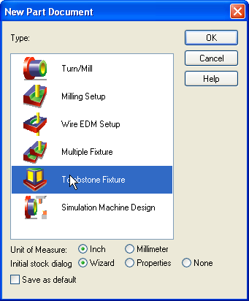
Tombstone
Creating a tombstone document
Notes:
Go to New Part document and Click on Tombstone

Slide 5
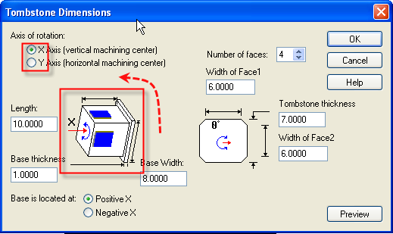
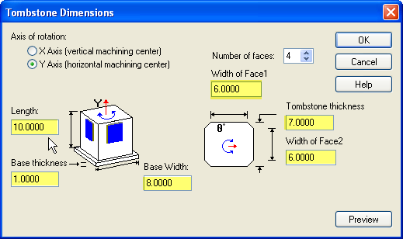
Tombstone
Setting up the tombstone
Notes:
Note: when you click on most radio buttons they will show a new direction display.
Note: If you have never used or set up Tomstone you will see this page and be prompted for Dimensions, otherwise you will see a different screen.
IMPORTANT: accurately reflect the dimensions of the tombstone (used for simulating toolpaths and to calculate the required retract distances)
1. Select the tombstone axis of rotation. Enter Y
2. Specify the number of faces of the tombstone. Enter 4
3. Specify the Axis Length. Enter 10
4. Specify the Base thickness. Enter 1
5. Specify the Base Width. Enter 8
6. Specify the Width of a Face. Enter 6
7. Specify the Tombstone thickness. Enter 7
8. Specify the Width of a Face 2. Enter 6
9. Click OK when finished

Slide 6
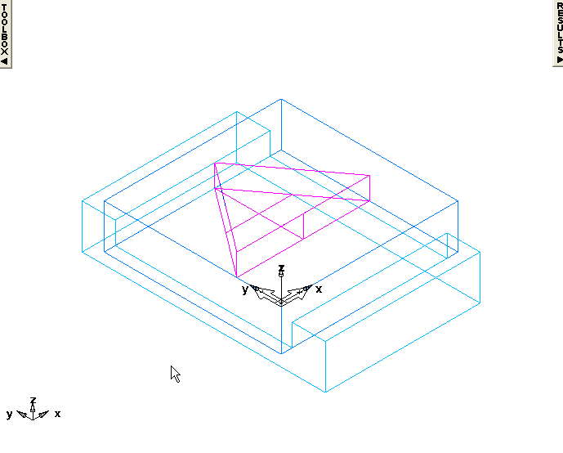
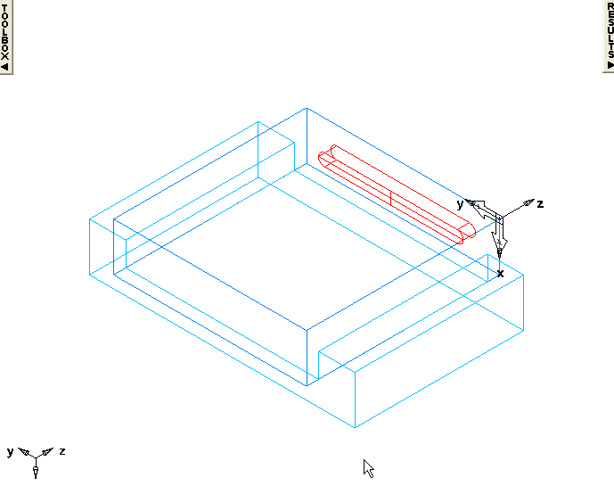
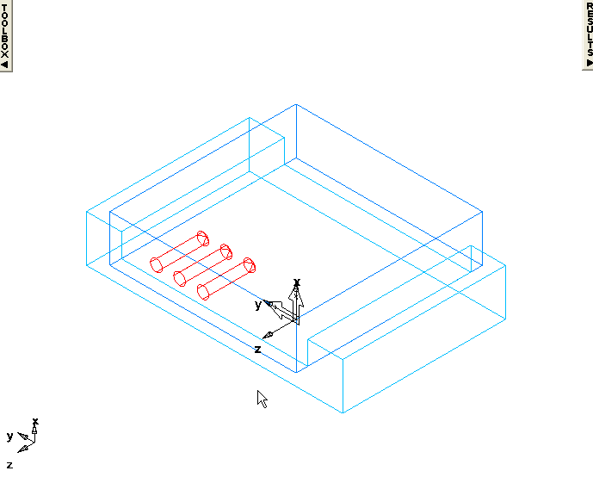
Importance of Setups in Tombstone
1.
3.
2.
Notes:
This is to make a part for Tombstone shown above file name= makeTSpart.fm or triangleTS.fm
How: create a new part with the stock dims W=4,L=4,TH=1 and, be sure to set your indexing to no muti axis (stock properties).
Create 3 setups Top, left side and right side The Top should be done already when you did the wizard now Create setup 2
Setup2. Go to new setup>align to stock face>stock face=left location, UR corner>Z rotate=90 & Preview then OK
Setup3. Go to new setup>align to stock face>stock face=right location, UL corner>Z rotate=90 & Preview then OK
Pocket:Click on Setup1 and then highlight curve 12 and click the NFW Icon (NEW FEATURE WIZARD) then select pocket from curve>>> then a depth = .5” and Finish
Holes:Click on Setup2 and click on the NFW and select Hole then check the box make pattern from ect….. > hole = plain hole, Dia=.25”,Depth=1,Chamfer=0 then next
Pattern Type=PointsPattern>select the point on the left and click set then click the next point and select Add do the same with the final hole.
If time allows show how to order the holes If not then Preview and Finish.
Slot:Click on Setup3 and go to the NFW select slot then next Set the following length=3”,width=.25”,depth=.25” angle=90 then Preview>
Location= X=.5” ,Y=.5” Z=0 and preview and Finish.
Make Clamp: Click on setup1 and go to iso view and highlight curve 13 then click on the Solid Wizard\define a custom ect… and next curve\extrude> extrude in the X direction
Set the X vector=3.5” and the X to=3.5 the rest of the numbers should be 0 (we are just extruding in the x direction 3.5”) click Preview and Finish.
Hiighlight and right click on the new solid and check the “use solid as clamp” in the flyout menu.

Slide 7

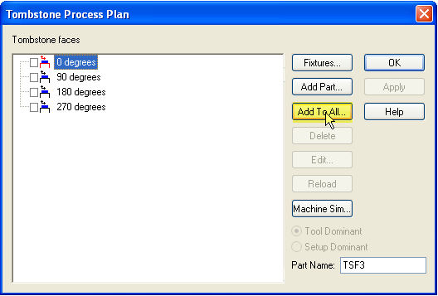
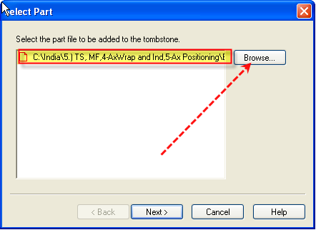
Tombstone
Adding parts
2.
1.
3.
Notes:
1. Bring up the Tombstone process plan dialog box by clicking the Parts step or double clicking in the graphics window.
2. Fixture Ids will be assigned to the parts beginning with the ID contained in the Start Fixture Ids
3. Click on the Add to all to position a part on all faces of the tombstone and bring up the select part dialog box
4. Bring up the select part dialog box

Slide 8
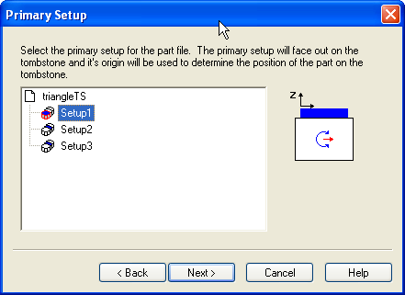
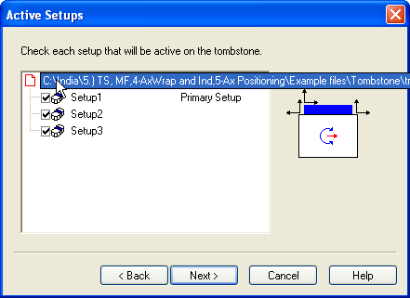
Select the Primary Setup
1.
2.

Slide 9
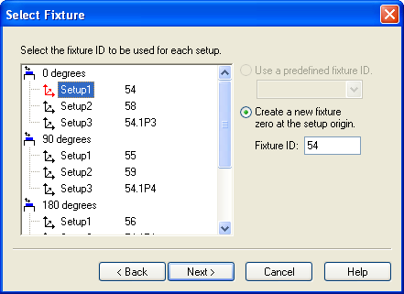
Select the Fixture ID
Notes:
In this example it is Offset 54

Slide 10
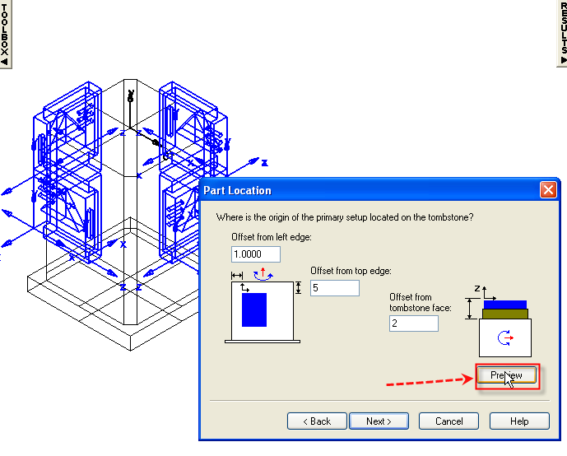
Part Location
Notes:
Tip: when doing part location be sure to change the numbers in the boxes then click the preview then make adjustments.
Enter 0,0,0 for all values to begin with and askthe class what numbers go where then
Enter the following correct numbers
Offset from left 1
Offset from top edge 5
Offset from tombstone face 2
Then click preview and next then run 3D sim

Slide 11
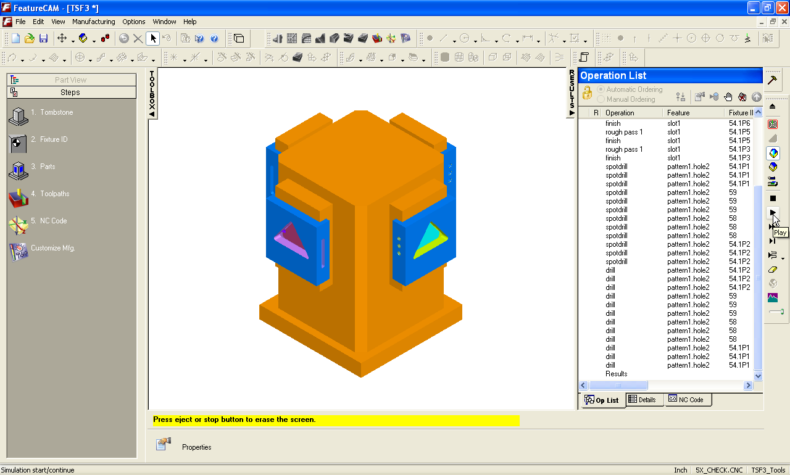
Run 3D Sim and check operations order

Slide 12
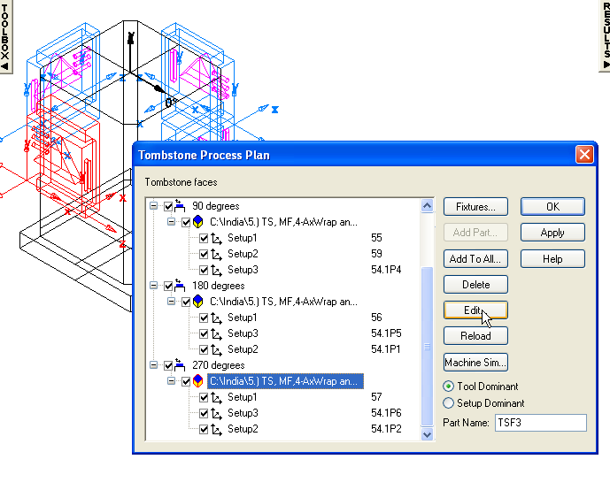
Edit Process Plan
Notes:
If you do not like the process plan you can doubleclick on one of the parts or click on the Parts Icon located in the Steps section
Highlight the operation 270 shown above then click the Edit button.

Slide 13
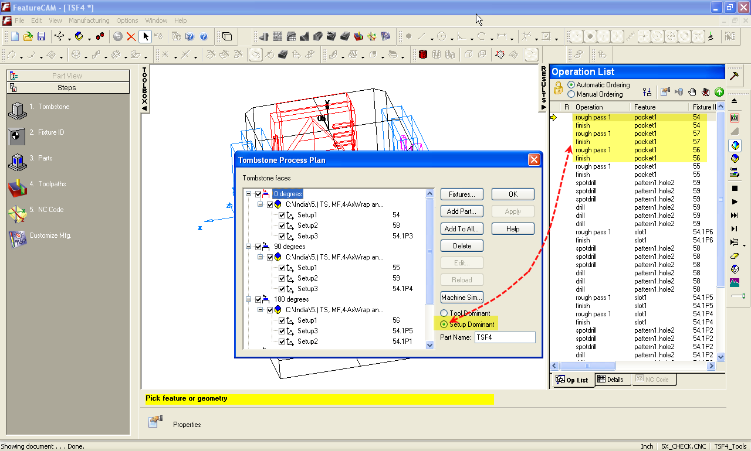
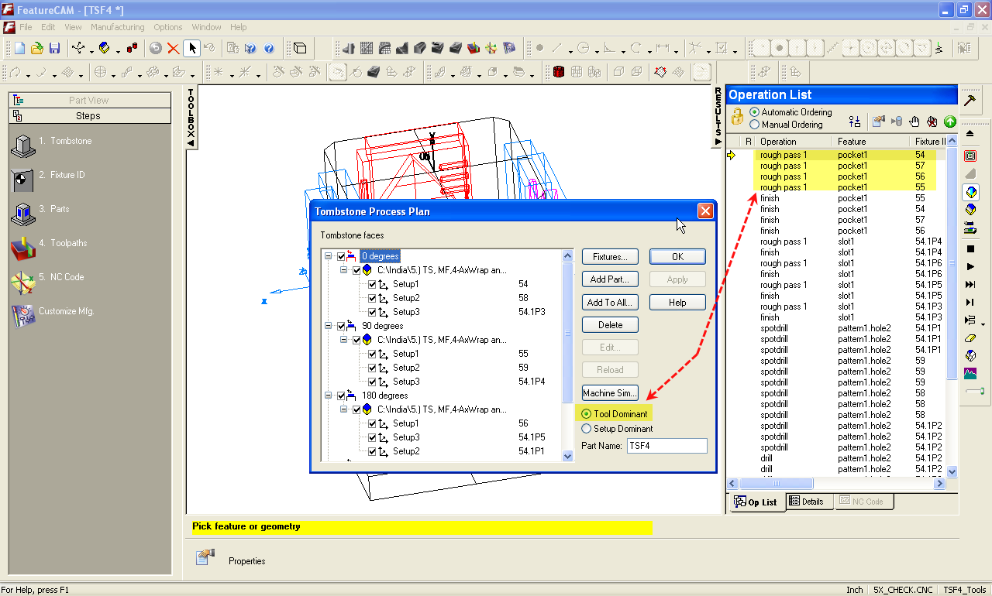
Tombstone
Specifying ordering of operations
Notes:
Now switch the Tool dominant and Setup dominant buttons and show the difference in Results\Operations window
1. Click on Parts step in the Steps toolbox.
2. If you want the ordering of operations to minimize tool changes across all setups, click Tool Dominant.
3. If you want the ordering of operations to complete each setup before moving on to another setup, click Setup Dominant. The order that operations are performed within a setup are determined by the milling ordering attributes.

Slide 14
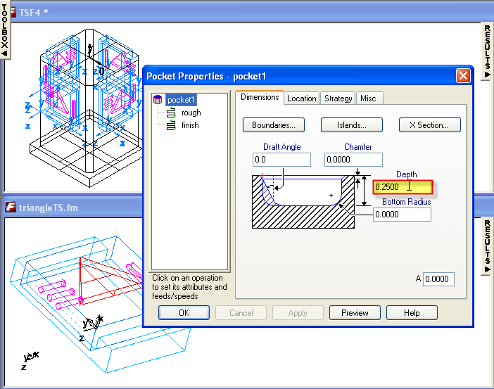
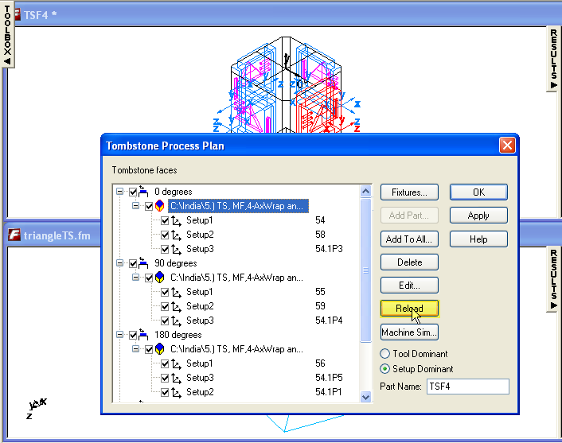
Tombstone Edit and Reload
Notes:
Open File TriangleTS.fm and view horizontally with split windows
Then go to the pocket properties and change the value to .25” click on OK
Then double click in the Tombstone graphics window and select O degree setup (this enables the reload buttton)
This button allows you to reload a FeatureCAM file into your tombstone document. If your initial part file has changed since you created your tombstone part, you’ll want to reload the part.
Steps to reload a part:
1. Click on a part filename.
2. Click the Reload button.

Slide 15
Multiple fixtures
Purpose
To cut different parts on your machine at once
With Multiple fixture parts, you can mix different setups from FeatureCAM parts.
FeatureCAM can then create a single program for cutting all the parts and it can minimize tool changes across all parts.
Notes:
Multiple fixture part
Selecting New from the File menu has an option unavailable from the New button on the Standard toolbar. That option is for a Multiple Fixture file. In this case, Setup can include other UCSs as well as entirely different part files.
Select the system units you’ll use for the multiple part document.
Choose whatever units match the parts.
When you create the new Multiple Fixture document, you select and orient the parts in the Multiple Fixtures dialog box.
The multiple fixture part can be either tool or part dominant. Tool Dominant files use the currently loaded tool every where possible before moving on to the next tool. It is a form of tool optimization. Part Dominant files cut every part completely (within the limits of the setup) before moving on to the next part.
Click Add to include parts in the multiple fixture part file.

Slide 16
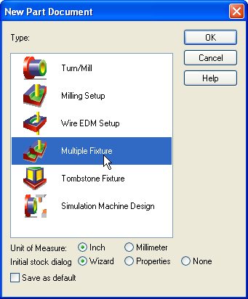
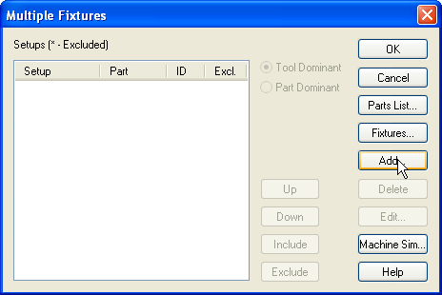
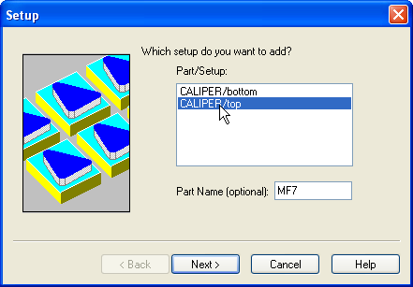
Multiple Fixtures
Creating a document
Notes:
NOTE: It is easier to open your part file before starting a Multi fixture file
Example: open Caliper.fm then go to new document\MFixture click on the Add then chose the CALIPER/top for part setup and next create a new fixture ect….
Start with 54> origin X=0,Y=0,Z=0
X Repeats=3 X spacing= 5
Y Repeats=3 Y spacing= 4 then next and Finish you have the option to select tool dominant or setup dominant Run 3D sim.
Note: you may have to change the tool so it doesn’t gouge the part next to it. To do this go to Parts\Parts list after making changes and click reload.

Slide 17
Multiple Fixtures
Fixture ID
This dialog box allows you to specify whether the part will be placed relative to an existing fixture ID or place independently by creating fixture IDs for each part placed.
Placing the parts relative to an existing fixture ID minimized the fixture IDs that are used, but requires you to setup your parts very accurately.
Creating a new fixture zero for each part gives you flexibility when placing the parts on the tombstone, but requires you to locate each part. It also may be impractical if you do not have enough fixture IDs

Slide 18
Multiple Fixtures
Parts list
it is easier to build the multiple fixture part if you already have the source files open in FeatureMILL (already loaded)
To put parts in the dialog box, use Add which opens the Setup dialog box. The Setup dialog box has the parts and setups from all the .fm files that FeatureMILL currently has open or that were selected in Parts List. Using Parts List now is a little more work than already having the files open.
Pick the part and setup in the list that you want to place in the multiple part file.

Slide 19
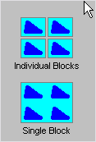
Multiple fixtures
Individual / Single blocks
Layout
This is where the multiple part file setup diverges. You can build each part in its own piece of stock material, or build them from one larger block of stock material.
Individual blocks are simpler to design, but perhaps less efficient.
Single block may minimize waste, but is more difficult to layout and fixture.

Slide 20

Multiple fixtures
Nesting
Depending on your part geometry, you might be able to make better use of a given stock size by nesting your parts. Nesting involves flipping the part around so that it can nest in the blank spots between other parts and can minimize waste in cutting some parts.

Slide 21
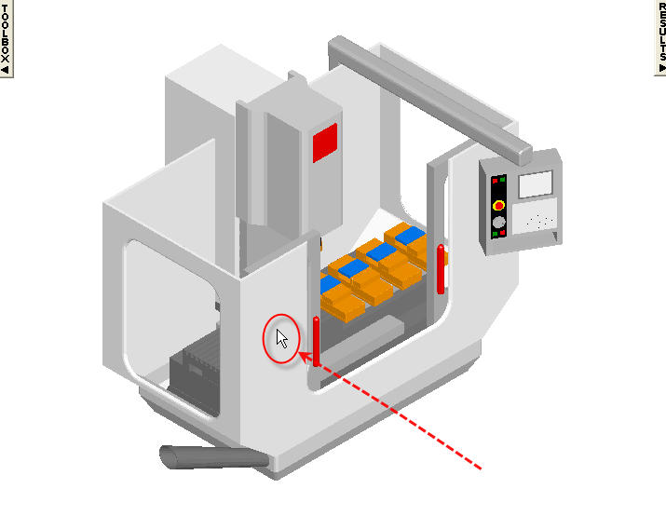
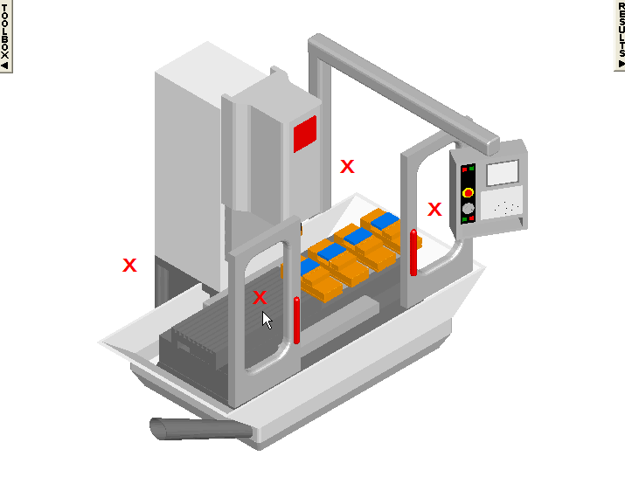
Multi Fixture with Machine Sim
Notes:
Example: Open MultiFixture.fm then open a new document Multi Fixture select the MultiFixture\Setup1 and next 2 times till you get to the configuration screen.
Start with 54>
origin X=0,Y=0,Z=0
X Repeats= 3 X spacing= 5
Y Repeats= 0 Y spacing= 0
then next and select individual blocks then next and Finish this will bring up the Multi Fixtures page click on the machine Sim icon
For this machine 2)HAAS 40x20 -(3AXIS Plain)-control.md
And enter these values for the machine sim dialog X= -20 Y= 0 Z= -6.23
Cick OK, and OK then click on the Machine Sim icon and and single step to load it and position it in the screen . Turn down the speed and press play
Note: to remove pieces of the machine press the select icon then pick on the machine panel you want to remove.
Note: you may have to change the tool so it doesn’t gouge the part next to it. To do this go to Parts\Parts list after making changes and click reload.

Slide 22
Tombstone
We keep the tool lower now between indexes

Slide 23
Questions?

